Slide 1
Corrections for asymmetry in high-throughput sequencing datasets applied to a meta-transcriptome dataset
🐯
🐞
👽
Greg Gloor, Jean Macklaim, Jia R. Wu
Department of Biochemistry
University of Western Ontario

Slide 2
Outline
🐯
🐞
👽
Demonstration of the problem
Problem applies, without restriction, to transcriptomics, meta-genomics, meta-transcriptomics, etc.
Tools in common use more sensitive to abundance than variance
Probabilities and compositions
Sequencing is not counting
Sequencing is a fixed-sum random sampling process
The fix and demonstration
Bacterial vaginosis

Slide 3
Bacterial vaginosis
🐯
🐞
👽
Most common vaginal dysbiosis
H is predominantly Lactobacillus sp.
BV is mixed bag of anaerobes with L. iners
Marked asymmetry in composition
Group genes to functional level (SEED, KEGG)
Sparse
Is anything different or is everything different?

Slide 4
Meta-transcriptomics of ecosystem
🐯
🐞
👽
Information about what is being made now
Often unbalanced
Different conditions can have different taxonomic compositions
Both absolute and relative abundance of the taxa and their transcripts can change
Relative abundance not necessarily reflective of 16S rRNA gene sequencing or metagenomic sequencing

Slide 5
BV dataset
Counts
Majority invariant
Dispersion ~ abundance
Dispersion NB or ZIG
🐯
🐞
👽
Notes:
Breaks the assumptions

Slide 6
The sequencing meat grinder
🐯
🐞
👽

Slide 7
We imagine
🐯
🐞
👽
👽
👽
👽
👽
Notes:
Starting with a of molecules composed of Tigers and Ladybugs
We take a random sample, how many Tigers and how many Ladybugs
If we count a given random area we can infer how many off each there are in entire set

Slide 8
Counting our things
🐯
🐞
👽
Example 100 random sample sets
range=1800-2200
range= 8000-12000
range=450-550
🐯
🐞
👽

Slide 9
HTS is not counting
Counts
Majority invariant
Dispersion ~ abundance
Dispersion NB or ZIG
🐯
🐞
👽
Sequencing machines randomly sample the environment with a fixed capacity
Cannot just ‘add one more read’ forever
They do not deliver counts
Probability of observing feature scaled by the total number of reads
Total is irrelevant
Friedman 2012 PLoS Comp Bio
Gloor, et al. 2016. Ann Epidemiology
Gloor, et al. 2016. Can J. Micro

Slide 10
HTS is not counting
🐯
🐞
👽
Sequencing machines randomly sample the environment with a fixed capacity
Cannot just ‘add one more read’ forever
They do not deliver counts
Probability of observing feature scaled by the total number of reads
Total is irrelevant
Friedman 2012 PLoS Comp Bio
Gloor, et al. 2016. Ann Epidemiology
Gloor, et al. 2016. Can J. Micro

Slide 11
Proportions have strange properties
🐯
🐞
👽
Constant sum of 1000
Constant sum operations:
Count normalization
Rarefaction
Proportion
percentage, relative abundance
RNA-seq, metagenomics, tag-sequencing
Gloor, et al. 2016. Ann Epidemiology
Gloor, et al. 2016. Can J. Micro

Slide 12
That can’t be normalized away
🐯
🐞
👽
Once data are on the simplex, they cannot be removed
Other distributions not as extreme, but same pattern

Slide 13
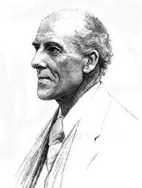
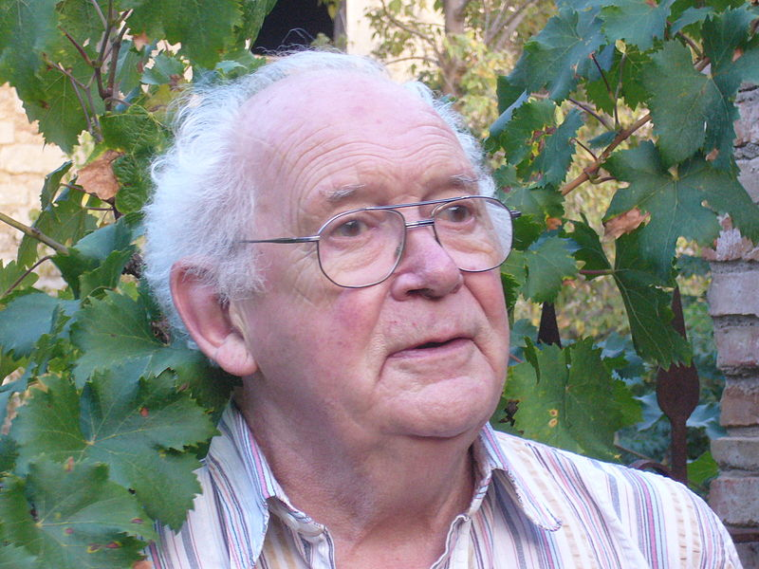
CoDa
🐯
🐞
👽
Compositional data are logically inconsistent with most tools in common use (Pearson 1897)
correlation, PCA etc.
negative binomial, rarefaction, ZIG
The solution is to work in ratios
Aitchison and others
Conceptually similar to qPCR

Slide 14
CoDa properties and *lr
Probabilities
Some invariant
Relative dispersion
Multivariate Poisson
Count
Sequencing
Simplex
🐯
🐞
👽
27
853
66
740
112
216
Simplex: one fewer dimensions than variables
Problems remain regardless of dimension
X = [ x₁, x₂, … x_{D} ], g_{X} = geometric mean of X (or subset)
*lr(x) = [ log(x₁/g_{X}), log(x₂/g_{X}), … log(x_{D}/g_{X}) ]
*lr transformed data are scale invariant
Formally, all pairs of ratios measured
Ratios are linearly related
Aitchison 1986. Stat. Anal. Comp Data
Pawlowsky-Glahn, 2015. Mod. Anal. CoDa
Notes:
Scale dependence - hence ‘normalization’
Correlation and covariation are unreliable
Addition and subtraction are not useful operations
Subsetting and aggregating are problematic
Sparse data is an issue

Slide 15
The 0 in the room
Probabilities
Some invariant
Relative dispersion
Multivariate Poisson
0 count can be real – or a non-detect
Sequencing instruments deliver scaled probabilities
X=[x₁,x₂,x_{i} … x_{D}] = [p₁,p₂,p_{i} … p_{D}]α ; α=ΣX; ΣP=1
x_{i} = ( P_{i} | 𝑓_{i} )α
Our approach (ALDEx2)
p_{i} = 0 is very strong assumption; [P_{i} > 0, P_{i} →0]
Generate a Bayesian posterior distribution of probabilities for each count in each sample; *lr transform the distribution; perform analyses on each element in the distribution; report expected values
Dramatically reduces false positives with little or no loss of sensitivity for essentially any seq’omics dataset
🐯
🐞
👽
Fernandes, PLoS ONE 2013
Gloor, Aus J. Stat. 2016
Thorsen, Microbiome 2016

Slide 16
BV dataset
Probabilities
Some invariant
Relative dispersion
Multivariate Poisson
🐯
🐞
👽

Slide 17
BV dataset
Probabilities
Some invariant
Relative dispersion
Multivariate Poisson
🐯
🐞
👽
qPCR validation by qPCR is ratio to ‘housekeeping’ subset
Assumes something is invariant
Housekeeping subsets off the midpoint
Low count margin also off midpoint

Slide 18
Three ways to centre
Probabilities
Some invariant
Relative dispersion
Multivariate Poisson
🐯
🐞
👽
X = [ x₁, x₂, … x_{D} ], g_{X} = geometric mean of X (or subset)
*lr(x) = [ log(x₁/g_{X}), log(x₂/g_{X}), … log(x_{D}/g_{X}) ]
IQlr(x) = [ log(x₁/I_{X}), log(x₂/I_{X}), … log(x_{D}/I_{X}) ]
IQx = geometric mean of features between q2-q3 in variance, per group
LVlr(x) = [ log(x₁/N_{X}), log(x₂/N_{X}), … log(x_{D}/N_{X}) ]
LVx = geometric mean of low variance, high abundance, per group
Ulr(x) = [ log(x₁/U_{X}), log(x₂/U_{X}), … log(x_{D}/U_{X}) ]
Ux = geometric mean of user-defined (housekeeping) features

Slide 19
And the winner is …
Probabilities
Some invariant
Relative dispersion
Multivariate Poisson
🐯
🐞
👽

Slide 20
Variance of the ratios
Probabilities
Some invariant
Relative dispersion
Multivariate Poisson
🐯
🐞
👽
Examine variance not abundance
Easily interpret relationships between samples and features
Robust to perturbations
Exploratory data analysis
Differential abundance
Compositional association
Notes:
Compositional data is analyzed based on the variance of the ratios between parts. Regardless of the approach the first step is to replace 0 values prior to clr transformation. This is an open problem, but the best current approaches incorporate Bayesian estimation. I am developing CoDaSeq, an integrated toolkit that adapts the tools used for compositional data analysis in other domains to the analysis if HTS. With these tools we can find outliers, perform exploratory data analysis, examine differential abundance and find associated variables. The toolkit is applicable to many different HTS designs including transcriptome, metagenome and 16S rRNA gene sequencing. The latter will be used as an esample, since these data are the least tractable to the CoDa approach

Slide 21
Two types of BV
Probabilities
Some invariant
Relative dispersion
Multivariate Poisson
H
BV1
BV2

Slide 22
Meta-transcriptome of H vs. BV
🐯
🐞
👽
Macklain, McMillan- PC
McMillan, Sci. Rep, 2015

Slide 23
Conclusions
🐯
🐞
👽
We only have relative information
Need to recast our questions. How are things changing relative to each other?
It takes a shift in thinking to interpret the data correctly
0 replacement is a theoretical, but not a practical impediment
Centering the data needed for interpretation of complex datasets
Variances of the ratios is informative
Same features are identified through multivariate ordination, univariate differential abundance, compositional association
Function trumps taxonomy
Gloor 2016, Aus. J. Stat

Slide 24

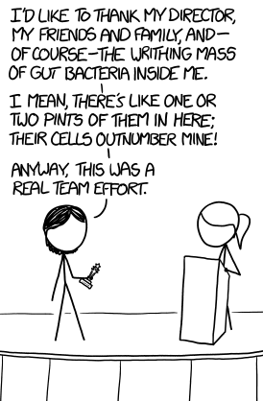


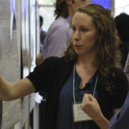



Acknowledgments
Workshop tomorrow
Andrew
Fernandes
Jean
Macklaim
Vera Pawlowsky-Glahn
Juan Jose Egozcue
Justin Silverman
philr (B’cor)
Tom Quinn
propr (CRAN)
🐯
🐞
👽
Gregor Reid
Jeremy Burton
Amy McMillan
Daniel Giguere
Jia Rong Wu
Notes:
Many more fragments than we can count

Slide 25
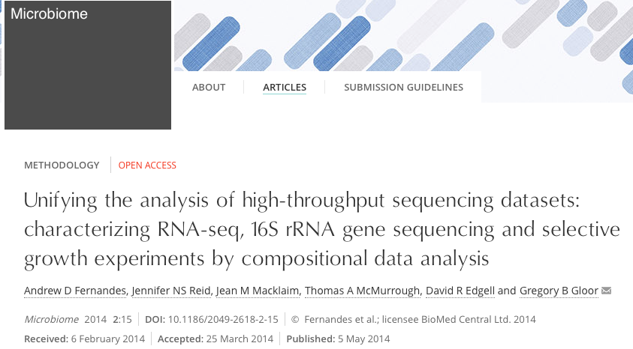

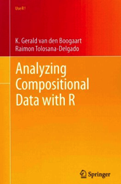
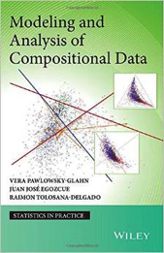
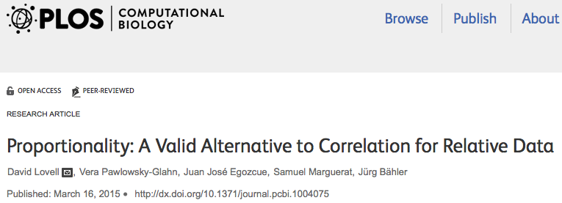
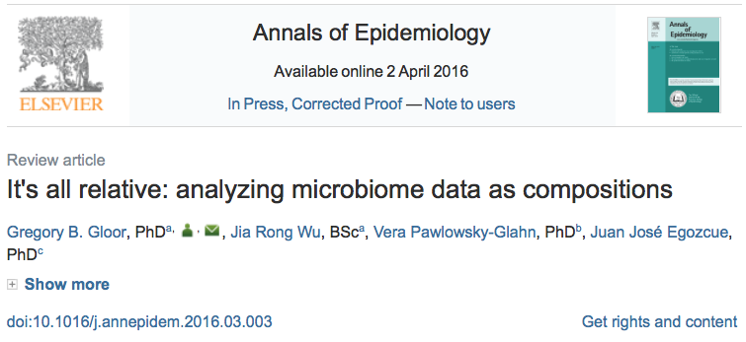

Reading & Sources
🐯
🐞
👽

